Slide 1
The Joys of JavaScript
Lesson 2.1

Slide 2
Homework #2 is due tonight!

Slide 3
Today’s Class

Slide 4


Class Objectives
In today’s class, we will introduce:
JavaScript Definitions
JavaScript Basics:
Variables
Logging, alerting, prompting
Arrays
If/else statements

Slide 5


JavaScript
Prepare to become true coders!
Notes:
shutterstock_795217711

Slide 6
How to Learn JavaScript

Slide 7

Your Brain on JavaScript
Notes:
shutterstock_184763024

Slide 8
Time to Take Notes!

Slide 9
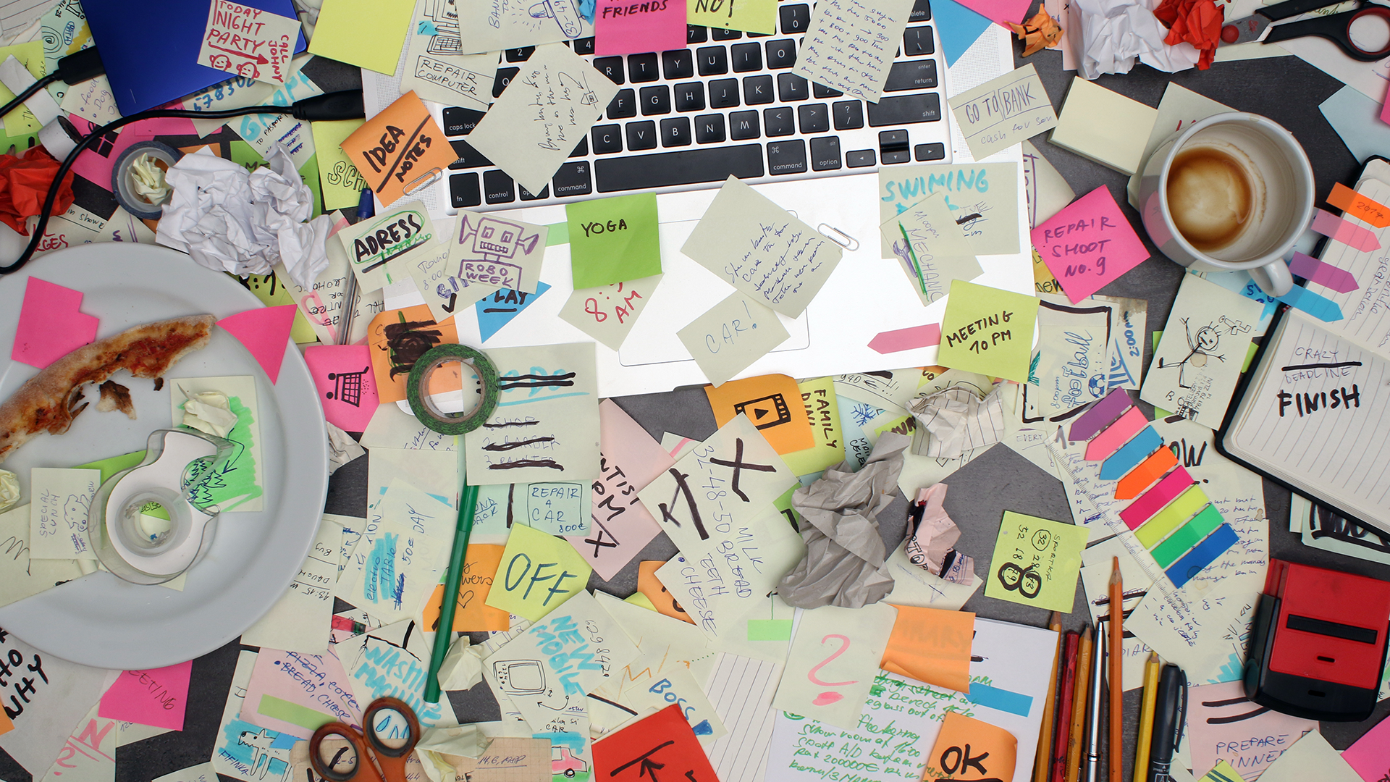
And Stay Organized!
Notes:
shutterstock_575384821

Slide 10
Learning JavaScript
Follow these general tips:
Review classwork immediately.
Redo class activities at home.
Come to office hours and keep asking questions.
Do not fear—you will get this!

Slide 11
Partner Activity: Code Dissection
A big part of being a developer is learning on the fly!
Instructions sent via Slack
7 minutes

Slide 12

Partner Activity: Code Dissection
Suggested Time: 7 minutes
01
Download the file sent to you via Slack.
02
Open it in Chrome and observe what happens.
03
With a partner, try to explain how the code connects to the events that happen on the page.
When downloading code from Slack, make sure you choose Download. If you copy and paste directly from Slack, your code will not work!

Slide 13
What Is JavaScript?

Slide 14


JavaScript Definition
JavaScript is one of the three fundamental programming languages of the modern web (the others are HTML and CSS).
HTML | CSS | JavaScript
Used to write content. | Used to format content. | Used to create dynamic web applications that take in user inputs, change what’s displayed to users, animate elements, and much more.

Slide 15
Variables

Slide 16
Variables
The nouns of programming
Numbers, strings, Booleans, etc.
Made up of a name and a value
var name = "Snow White"; var dwarfCount = 7; var isSleeping = true;

Slide 17
Variables

Slide 18
Variable Basics: Syntax
Var keyword | Variable name | Assignment | Value | Termination
var | name | = | "Snow White" | ;

Slide 19
Variable Basics: Syntax
Var Keyword | Variable name | Assignment | Value | Termination
var | name | = | "Snow White" | ;
 |  |  | Be sure to notice the quotes (""), which convey that Snow White is a string.

Slide 20
Activity: Variables
In this activity, you will fill in the missing JavaScript code to create variables.
Instructions sent via Slack
10 minutes

Slide 21
Activity: Variables
Suggested Time: 10 minutes
01
Using the instructions in the file sent to you, fill in the missing JavaScript code to create variables.
02
When you are done, open the file in Chrome and check the output.
03
If you successfully complete the activity, you will see a series of pop-up windows with text inside.
Finally, look at the rest of the code and try to figure out why the text displayed the way it did.
04

Slide 23
Console Log

Slide 24
Console Log

Slide 25
Console.log
console.log is a quick expression that prints content to the debugger—very useful during development and debugging!
var quick = "Fox"; var slow = "Turtle"; var numbers = 121; // The console.log() method is used to display data in the the browser’s console. // We can log strings, variables, and even equations. console.log("Teacher"); console.log(quick); console.log(slow); console.log(numbers + 15);

Slide 26
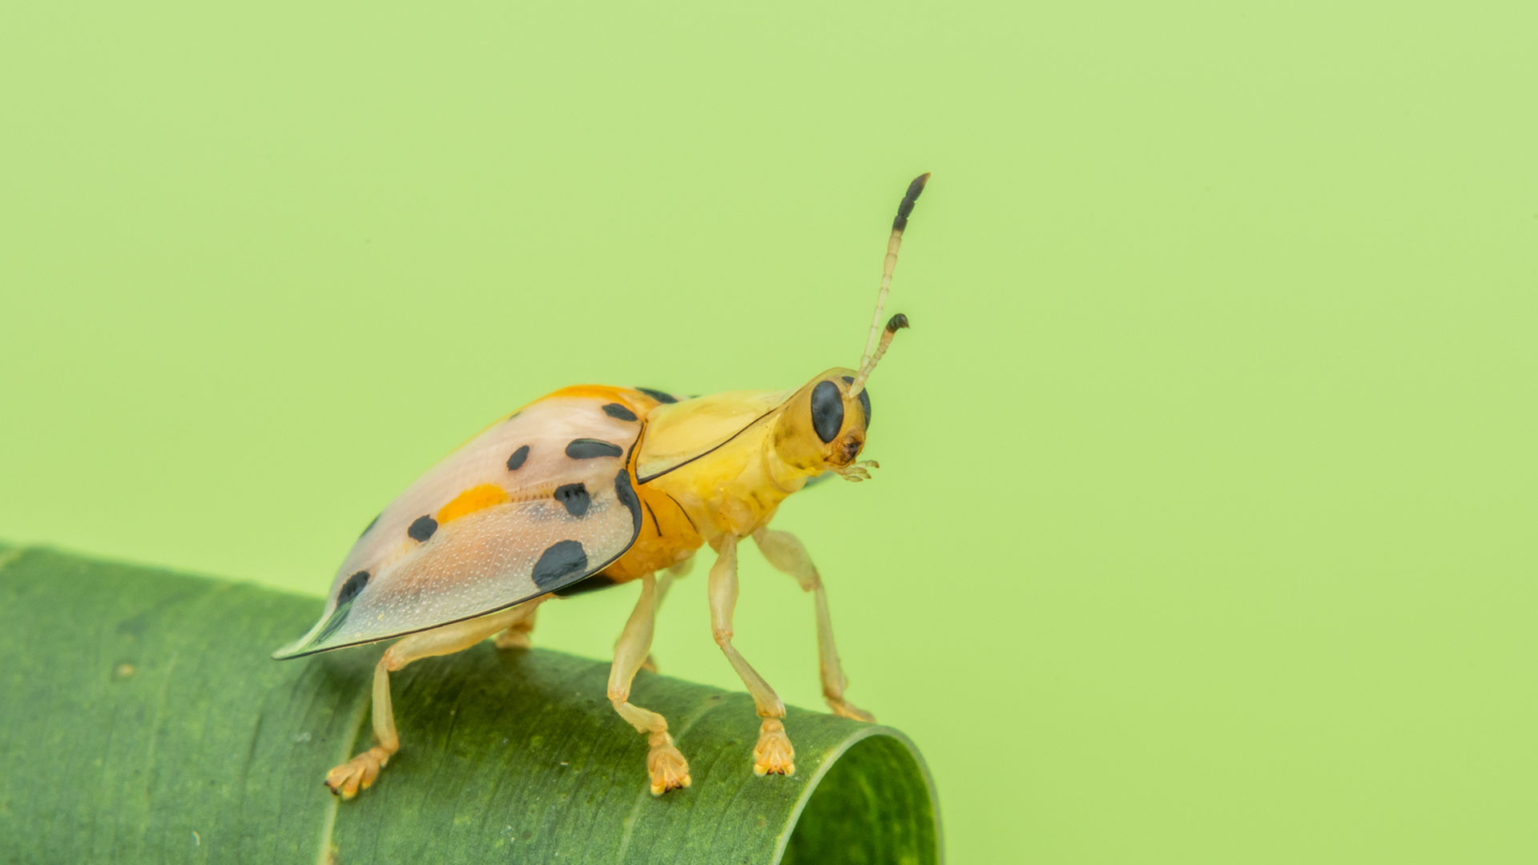
How do you comfort a JavaScript bug?
Notes:
shutterstock_1242632743

Slide 27
How do you comfort a JavaScript bug?
You "console" it!
Notes:
shutterstock_1242632743

Slide 28
Activity: Console Log
Instructions sent via Slack
7 minutes

Slide 29
Activity: Console Log
Suggested Time: 7 minutes
01
Using the file sent to you as a guide, modify the code so that is uses console.log instead of alerts to display messages.
Then open the file in the browser and open up Chrome Developer Tools -> Console to confirm that the changes worked.
02
With a partner, discuss the difference between console.log and alert.
03
alert("Welcome: " + name); alert("Pizzas cost $5 each"); alert("Your total is: $" + totalCost); alert("Still Hungry: " + isHungry);

Slide 30
Alerts, Prompts, Confirms

Slide 31
Alerts, Prompts, Confirms

Slide 32
Alerts, Prompts, Confirms
Alerts, prompts, and confirms create a popup in the browser when run.
These are also useful for development and debugging.
// Alert alert("We definitely rock!"); // Confirm var doYouRock = confirm("The question is, do *you* rock?"); // Prompt var howMuchRock = prompt("How much do you rock?");
This page says:
We definitely rock!
OK
This page says:
The question is, do “you” rock?
Prevent this page from creating additional dialogs.
OK
Cancel
This page says:
How much do you rock?
Prevent this page from creating additional dialogs.
OK
Cancel

Slide 33
Activity: Alerts
Instructions sent via Slack
15 minutes

Slide 34
Activity: Alerts
Suggested Time: 15 minutes
Write JavaScript code that does the following:
01
Using a confirm, ask the user “Do you like _____?” and store their response in a variable.
Using a prompt, ask the user: “What kind of _____ do you like?” and store their response in a variable.
02
alert both variables to the screen.
03

Slide 36
If/Else Statements

Slide 37
Conditionals

Slide 38
If/Else Statements Are Critical
Each statement is composed of an if, else-if, or else (keyword), a condition, and the resulting code in curly brackets { }.
// If the user likes sushi (confirmSushi === true), we run the following block of code. if (confirmSushi) { alert("You like " + sushiType + "!"); } // If the user likes ginger tea (confirmGingerTea === true), we run the following block of code. else if (confirmGingerTea) { alert("You like ginger tea!!"); } // If neither of the previous condition were true, we run the following block of code. else { alert("You don’t like sushi or ginger tea.");

Slide 39
Partner Activity: If/Else Part 1
With a partner you will create a website (from scratch) that asks users if they eat steak.
15 minutes

Slide 40
Partner Activity: If/Else Part 1
Suggested Time: 15 minutes
01
With a partner, create a website (from scratch) that asks users if they eat steak.
If they respond with yes, alert the following to the page: “Here’s a Steak Sandwich!”.
02
If they respond with no alert the following to the page: “Here’s a Tofu Stir-Fry!”.
03
Bonus: Ask what the user’s birth year is. If they are under 21, alert the following: “No sake for you!”

Slide 42
Activity: If/Else Part 2
As a class, we will go through and predict what the result of a conditional statement will be.
Instructions sent via Slack.
10 minutes

Slide 43
Activity: If/Else Part 2
Suggested Time: 10 minutes
Do this activity as a class.
Open the file sent to you in Sublime.
As a class, go through and predict what the result of each conditional statement will be (i.e., will the “if” or the “else” be triggered).
Then run the program to check if you are right. Note any that you got wrong and ask about it in class.

Slide 45
Arrays

Slide 46
The Zoo Pen
Array Name: zooAnimals
Zebra | Rhino | Giraffe | Owl
Index 0 | Index 1 | Index 2 | Index 3

Slide 47
The Zoo Pen: Coded
Array Name: zooAnimals
Coded in JavaScript using an Array
Coded in JavaScript using an array:
Zebra | Rhino | Giraffe | Owl
Index 0 | Index 1 | Index 2 | Index 3
// Our array of zoo animals. var zooAnimals = ["Zebra", "Rhino", "Giraffe", "Owl"];

Slide 48
Arrays
Arrays are a type of variable that are collections.
These collections can be made up of strings, numbers, Booleans, other arrays, objects … anything.
Each element of the array is marked by an index. Indexes always start with 0.
var nickCharacters = ["Tommy", "Doug", "Oblina"]; var diceNumbers = [1, 2, 3, 4, 5, 6,]; var mixedArray = ["Zoo", 12, "Carrot", 3];

Slide 49
Arrays: Indices
To recover the value at any specific index, include the name of the array with a square bracket [ ] and inside the bracket is the element’s index.
You can easily grab the number of elements in the array using the method array.length.
// Our array of zoo animals. var zooAnimals = ["Zebra", "Rhino", "Giraffe", "Owl"]; // Prints 4 to the console because there are 4 items in our zooAnimals array. console.log(zooAnimals.length); // Prints Rhino to the console. Remember, the first item in an array has an index position of 0! console.log(zooAnimals[1]); // Prints undefined...because the last index ("Owl") is 3. console.log(zooAnimals[4]);

Slide 50
Arrays

Slide 51
Partner Activity: Code Dissection
Suggested Time: 7 minutes
With a partner, take a few moments to look over the following code (sent via Slack).
Above each console.log(), write a comment predicting what you think the output will be.

Slide 52
Challenge: Favorite Band Array
In this challenge, you will create an array of your favorite bands.
10 minutes

Slide 53
Challenge: Favorite Band Array
Suggested Time: 15 minutes
Create a website that accomplishes the following:
01
Create an array of your favorite bands.
02
With a prompt, ask the user’s favorite band.
03
If it’s one of your favorites, alert: “YEAH, I LOVE THEM!”
04
If it’s not, alert: “Nah. They’re pretty lame.”
Hint: You will need to research how to use .indexOf()
Hint: You will also need to research how to use .toLowerCase()

Slide 54
Challenge: Code Dissection (Re-examined)
Re-examine the file sent to you at the start of class. See if you can better understand how it works after having completed today’s class.
5 minutes

Slide 55
For Loops

Slide 56
Back to The Zoo Pen
Array Name: zooAnimals
Coded in JavaScript using an Array
Coded in JavaScript using an Array
Zebra | Rhino | Giraffe | Owl
Index 0 | Index 1 | Index 2 | Index 3
// Our array of zoo animals. var zooAnimals = ["Zebra", "Rhino", "Giraffe", "Owl"];

Slide 57
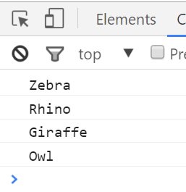
Back to The Zoo Pen
Array Name: zooAnimals
Coded in JavaScript using an Array
Zebra | Rhino | Giraffe | Owl
Index 0 | Index 1 | Index 2 | Index 3
// Array of zoo animals. var zooAnimals = ["Zebra", "Rhino", "Giraffe", "Owl"]; console.log(zooAnimals[0]); console.log(zooAnimals[1]); console.log(zooAnimals[2]); console.log(zooAnimals[3]);

Slide 58
What’s wrong here?
// Array of zoo animals. var zooAnimals = ["Zebra", "Rhino", "Giraffe", "Owl"]; console.log(zooAnimals[0]; console.log(zooAnimals[1]; console.log(zooAnimals[2]; console.log(zooAnimals[3];

Slide 59
Don’t Repeat Yourself (DRY)
Repeated Code! Let’s be more efficient.
// Array of zoo animals. var zooAnimals = ["Zebra", "Rhino", "Giraffe", "Owl"]; console.log(zooAnimals[0]; console.log(zooAnimals[1]; console.log(zooAnimals[2]; console.log(zooAnimals[3];

Slide 60
Activity: For Loop Dissection
5 minutes

Slide 61

Activity: For Loop Dissection
Suggested Time: 5 minutes
With a partner, spend a few moments trying to dissect the code sent to you.
Try to explain to one another what is happening in each line of code.
Feel free to do research if you are stumped. As a hint, look into the phrase “for loop”.
Be prepared to share when time is up.

Slide 62
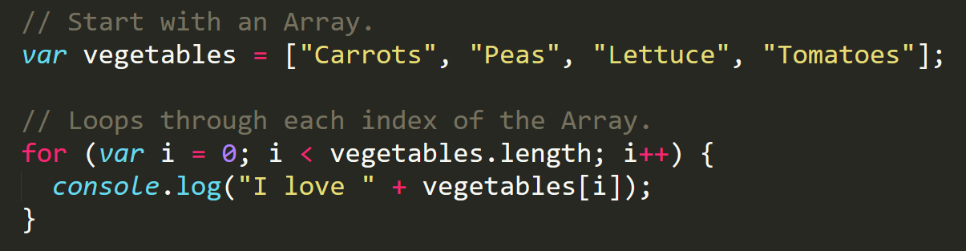
Enter the For Loop
For loops are critical in programming. We use for loops to run repeated blocks of code over a set period.
Each for loop is composed of a:
Variable declaration or counter (iterator)
Loop condition
Iteration (addition)

Slide 63
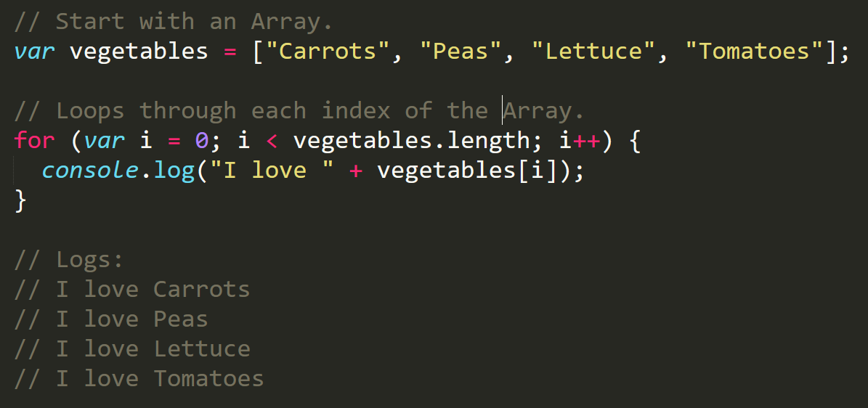
Enter the For Loop
Iterator
Condition
Increment

Slide 64
Enter the For Loop
Code between the { } gets repeated each time the iterator is smaller than the condition (in this case, as long as i < 4).

Slide 65
Enter the For-Loop
Running the code “loops” through and prints each element in the array.

Slide 66
Run That Loop
When i = 0 … console.log(“I love Carrots”)
Carrots | Peas | Lettuce | Tomatoes
Index 0 | Index 1 | Index 2 | Index 3

Slide 67
Run That Loop
When i = 1 … console.log(“I love Peas”)
Carrots | Peas | Lettuce | Tomatoes
Index 0 | Index 1 | Index 2 | Index 3

Slide 68
Run That Loop
When i = 2 … console.log(“I love Lettuce”)
Carrots | Peas | Lettuce | Tomatoes
Index 0 | Index 1 | Index 2 | Index 3

Slide 69
Run That Loop
When i = 3 … console.log(“I love Tomatoes”)
Carrots | Peas | Lettuce | Tomatoes
Index 0 | Index 1 | Index 2 | Index 3

Slide 70
Activity: For Loop Zoo
15 minutes

Slide 71
Activity: For Loop Zoo
Suggested Time: 15 minutes
01
Spend a few moments rewriting the code below using a for loop.
02
If you need help, use the code from the previous example as a guide.
03
Then try to explain to the person next to you how your code works.
// Array of zoo animals. var zooAnimals = ["Zebra", "Rhino", "Giraffe", "Owl"]; console.log(zooAnimals[0]; console.log(zooAnimals[1]; console.log(zooAnimals[2]; console.log(zooAnimals[3];

Slide 72
Questions?

